Slide 1
Microsoft Azure Fundamentals
By Vineela

Slide 2
Topics
Describe what is Cloud Computing
Describe terms such as High Availability, Scalability, Elasticity, Agility, Fault Tolerance, and Disaster Recovery
Describe the principles of economies of scale
Describe the differences between Capital Expenditure (CapEx) and Operational Expenditure (OpEx)
Describe the consumption-based model
Describe Infrastructure-as-a-Service (IaaS)
Describe Platform-as-a-Service (PaaS)
Describe Software-as-a-Service (SaaS)
Describe Public cloud
Describe Private cloud
Describe Hybrid cloud

Slide 3
Topics
Describe Data Centers
Describe Regions and Region Pairs
Describe Geographies
Describe Availability Zones
Describe the benefits and usage of core Azure architectural components (Regions & Availability Zones)
Describe Resources
Describe Resource Groups
Describe Azure Resource Manager
Describe the benefits and usage of core Azure architectural components (Azure Resource Manager & Resource Groups)
Describe products available for Compute such as Virtual Machines, Virtual Machine Scale Sets, App Services, Functions, Azure Container Instances (ACI) and Azure Kubernetes Service (AKS)

Slide 4
Topics
Describe products available for Networking such as Virtual Network, Load Balancer, VPN Gateway, Application Gateway and Content Delivery Network
Describe products available for Storage such as Blob Storage, File Storage, Queue Storage, Table Storage, Disk Storage, and Storage Tiers
Describe the benefits and usage of Cosmos DB, Azure SQL Database, Azure Database for MySQL, Azure Database for PostgreSQL, and SQL Managed Instance
Describe the Azure Marketplace
Describe the benefits and usage of Internet of Things (IoT) Hub, IoT Central, and Azure Sphere
Describe the benefits and usage of Azure Synapse Analytics, HDInsight, and Azure Databricks
Describe Artificial Intelligence (AI) and products that are available for AI such as Azure Machine Learning Service and Studio
Describe Serverless computing and Azure products that are available for serverless computing such as Azure Functions, Logic Apps, and Event Grid

Slide 5
Topics
Describe DevOps solutions available on Azure such as Azure DevOps and Azure DevTest Labs
Describe Azure management tools such as Azure Portal, Azure PowerShell, Azure CLI and Cloud Shell
Describe Azure Advisor
Describe Network Security Groups (NSG)
Describe Application Security Groups (ASG)
Describe User-defined Routes (UDR)
Describe Azure Firewall
Describe Azure DDoS Protection

Slide 6
Topics
Describe core Azure Identity services
Describe the difference between authentication and authorization
Describe Azure Active Directory
Describe Azure Multi-Factor Authentication
Describe security tools and features of Azure
Describe Azure Security Center
Describe Azure Security Center usage scenarios
Describe Azure Key Vault
Describe Azure governance features
Describe the functionality and usage of Role-Based Access Control (RBAC)
Describe the functionality and usage of resource locks
Describe the functionality and usage of tags

Slide 7
Topics
Describe the functionality and usage of Azure Policy
Describe the functionality and usage of Azure Blueprints
Describe the Cloud Adoption Framework for Azure
Describe privacy and compliance resources
Describe the purpose of the Microsoft Privacy Statement, Online Services Terms (OST) and Data Protection Amendment (DPA)
Describe the purpose of the Trust Center
Describe the purpose of the Azure compliance documentation
Describe the purpose of Azure Sovereign Regions (Azure Government cloud services and Azure China cloud services)
Identify factors that can affect costs (resource types, services, locations, ingress and egress traffic)

Slide 8
Topics
Identify factors that can reduce costs (reserved instances, reserved capacity, hybrid use benefit, spot pricing)
Describe the functionality and usage of the Pricing calculator and the Total Cost of Ownership (TCO) calculator
Describe the functionality and usage of Azure Cost Management
Describe the purpose of an Azure Service Level Agreement (SLA)
Identify actions that can impact an SLA (i.e. Availability Zones)
Describe the service lifecycle in Azure (Public Preview and General Availability)

Slide 9
Cloud Computing Service delivery model over the internet (cloud). This includes but is not limited to compute power meaning servers such as windows, linux, hosting environments, etc. storage like files and/or databases networking in azure but also outside when connecting to your company network analytics services for visualization and telemetry data Key concepts scalability is the ability to scale, so allocate and deallocate resources at any time elasticity is the ability to scale dynamically agility is the ability to react fast (scale quickly) fault tolerance is the ability to maintain system uptime while physical and service component failures happen disaster recovery is the process and design principle which allows a system to recovers from natural or human induced disasters high availability is the agreed level of operational uptime for the system. It is a simple calculation of system uptime versus whole lifetime of the system. availability = uptime/(uptime + downtime)

Slide 10
Economies of Scale The principle of economies of scale states that as the companies grow they become more effective at managing shared operations. Be that HR and hiring, taxes, accounting, internal operations, marketing, big purchases via contracts meaning better discounts, etc. etc. Because of those, companies can save/earn more which in return allows for reduction in cost of their services to their customers. This is so called ‘price per unit’. It’s not possible to go to 0 because in the end some underlying infrastructure needs to run to provide the services. But the larger the scale the more benefits can be passed to customers. In fact, in the current scale, Microsoft can already offer multiple services for free due to how small a fraction of the cost it is for them.

Slide 11
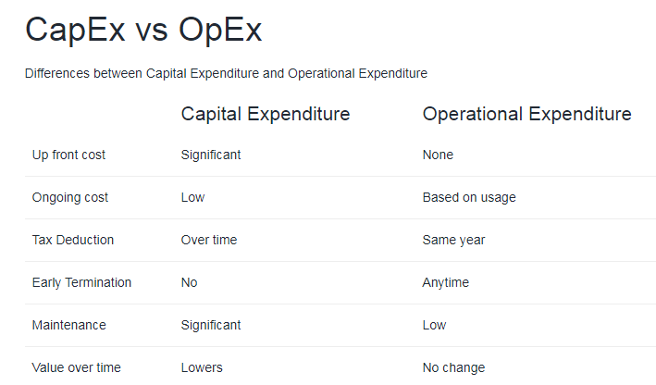

Slide 12
What is a consumption-based model? The consumption-based model is a pricing model used in the cloud so that customers are only charged based on their resource usage. This model is characterized by No associated upfront cost No wasted resources as such no charges are incurred for unused resources*. Unused in this case is different per service. For instance, blob storage that stores any data is considered to be used, as it consumes the storage space. Virtual Machines that are running consume CPU, memory and other resources even if there isn’t any traffic. Hence they are considered to be used and will incur charges. Pay for what you need Stop paying when you don’t Consumption is the virtual metric used to calculate how much each resource (service) in Azure was used. Each service has many smaller metrics that track its consumption to offer best possible pricing model. Those metrics are tracked on very granular level.

Slide 13
Service Models responsibilities As a service means which party will manage the particular layer and all the layers below. Software layer consists the application (application code and set) & the application data Platform layer means all the supporting software and the operating system required to host the application Infrastructure layer consists hardware the infrastructure and virtualization required to host the platform

Slide 14
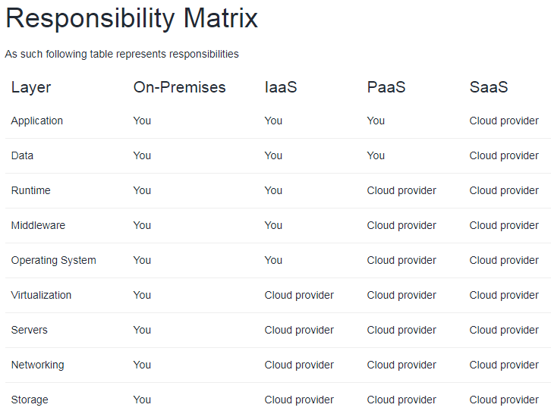
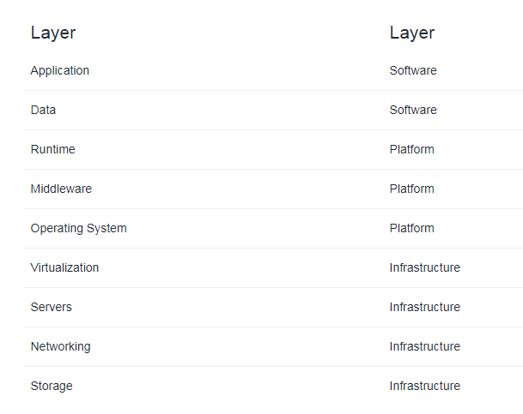

Slide 15
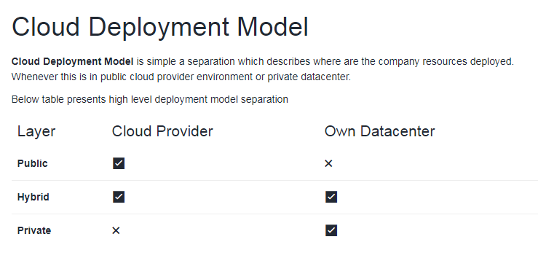

Slide 16
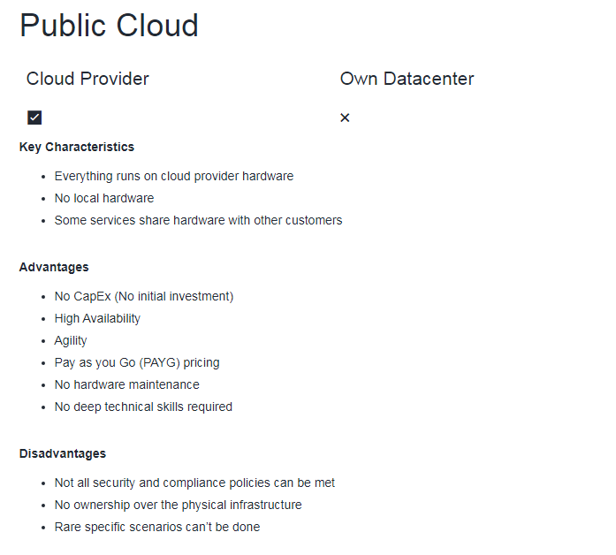

Slide 17
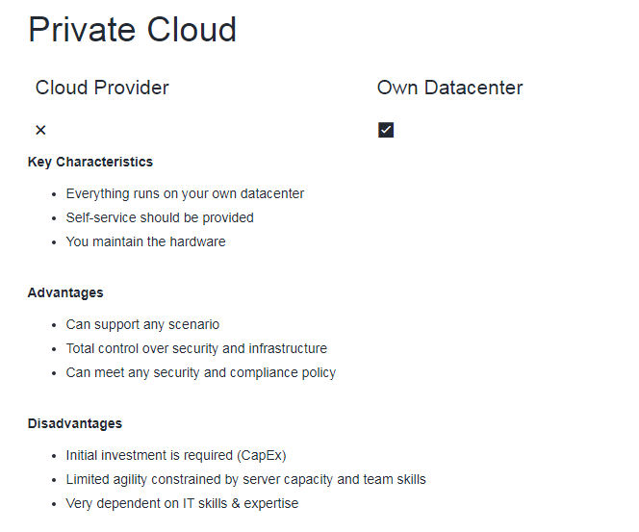

Slide 18
Service Models responsibilities As a service means which party will manage the particular layer and all the layers below. Software layer consists the application (application code and set) & the application data Platform layer means all the supporting software and the operating system required to host the application Infrastructure layer consists hardware the infrastructure and virtualization required to host the platform

Slide 19
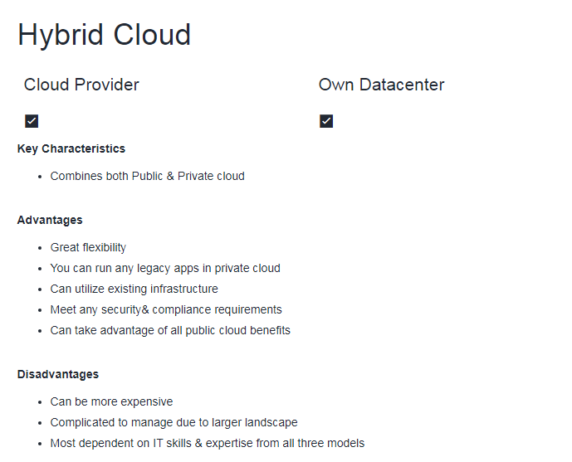

Slide 20
Data Center Physical facility Hosting for group of networked servers Own power, cooling & networking infrastructure

Slide 21
Region Geographical area on the planet One but usually more datacenters connected with low-latency network (<2 milliseconds) Location for your services Some services are available only in certain regions Some services are global services, as such are not assigned/deployed in specific region Globally available with **50+ regions ** Special government regions (US DoD Central, US Gov Virginia, etc.) Special partnered regions (China East, China North)

Slide 22
Availability Zone Regional feature Grouping of physically separate facilities Designed to protect from data center failures If zone goes down others continue working Two service categories Zonal services (Virtual Machines, Disks, etc.) Zone-redundant services (SQL, Storage, etc.) Not all regions are supported Supported region has **three or more zones ** A zone is one or more data centers

Slide 23
Region Pair Each region is paired with another region making it a region pair Region pairs are static and cannot be chosen Each pair resides within the same geography* Exception is Brazil South Physical isolation with at least 300 miles distance (when possible) Some services have platform-provided replication Planned updates across the pairs Data residency maintained for disaster recovery

Slide 24
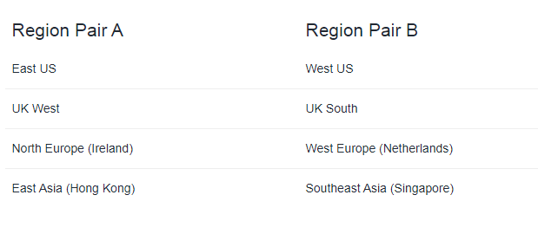

Slide 25
Geographies Discrete market Typically contains two or more regions Ensures data residency, sovereignty, resiliency, and compliance requirements are met Fault tolerant to protect from region wide failures Broken up into areas Americas, Europe, Asia Pacific, Middle East and Africa Each region belongs only to one Geography

Slide 26
Azure Resource Object used to manage services in Azure Represents service lifecycle Saved as JSON definition Resource Groups Grouping of resources Holds logically related resources Typically organizing by Type Lifecycle (app, environment) Department Billing, Location or combination of those Resource Manager Management Layer for all resources and resource groups Unified language Controls access and resources

Slide 27
Additional Info Each resource must be in one, and only one resource group Resource groups have their own location assigned Resources in the resource groups can reside in a different locations Resources can be moved between the resource groups Resource groups can’t be nested Organize based on your organization needs but consider Billing Security and access management Application Lifecycle

Slide 28
Virtualization Emulation of physical machines Different virtual hardware configuration per machine/app Different operating systems per machine/app Total separation of environments file systems, services,ports,middleware,configuration

Slide 29
Virtual Machines Infrastructure as a Service (IaaS) Total control over the operating system and the software Supports marketplace and custom images Best suited for Custom software requiring custom system configuration Lift-and-shift scenarios Can run any application/scenario web apps & web services, databases, desktop applications, jumpboxes, gateways, etc

Slide 30
Virtual Machine Scale Sets Infrastructure as a Service (IaaS) Set of identical virtual machines Built-in auto scaling features Designed for manual and auto-scaled workloads like web services,* batch processing, etc.

Slide 31
Containers Use host’s operating system Emulate operating system (VMs emulate hardware) Lightweight (no O/S) Development Effort Maintenance Compute & storage requirements Respond quicker to demand changes Designed for almost any scenario

Slide 32
Azure Container Instances Simplest and fastest way to run a container in Azure Platform as a Service Serverless Containers Designed for Small and simple web apps/services Background jobs Scheduled scripts

Slide 33
Azure Kubernetes Service (AKS) Open-source container orchestration platform Platform as a Service Highly scalable and customizable Designed for high scale container deployments (anything really!) App Service Designed as enterprise grade web application service Platform as a Service Supports multiple programming languages and containers

Slide 34
Azure Functions (Function Apps) Platform as a Service Serverless Two hosting/pricing models Consumption-based plan Dedicated plan Designed for micro/nano-services

Slide 35
Summary Virtual Machines (IaaS) - Custom software, custom requirements, very specialized, high degree of control VM Scale Sets (IaaS) - Auto-scaled workloads for VMs Container Instances (PaaS) - Simple container hosting, easy to start Kubernetes Service (PaaS) - Highly scalable and customizable * container hosting platform App Services (PaaS) - Web applications, a lot of enterprise web * hosting features, easy to start Functions (PaaS) (Function as a Service) (Serverless) - micro/nano-services, excellent consumption-based pricing, easy to start

Slide 36
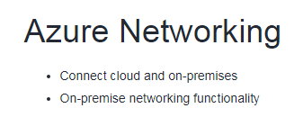
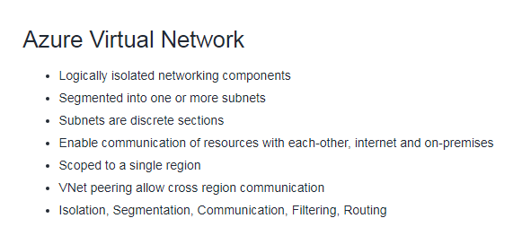
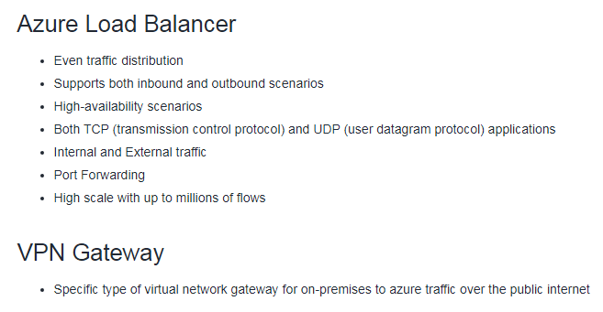
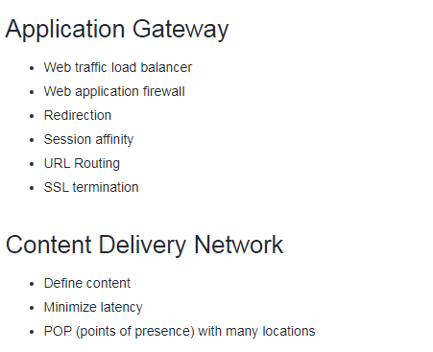

Slide 37
Data Types
Structured - Data that can be represented using tables with very strict schema. Each row must follow defined schema. Some tables have defined relationships between them. Typically used in relational databases.
Semi-structured - Data that can be represented using tables but without strict defined schema. Rows must only have unique key identifier.
Unstructured - Any files in any format. Like binary files, application files, images, movies, etc.
Storage Account
Group of services which include
blob storage,
queue storage,
table storage, and
file storage
Used to store
files,
messages, and
semi-structured data
Highly scalable (up to petabytes of data)
Highly durable (99.999999999% - 11 nines, up to 16 nines)
Cheapest per GB storage

Slide 38
Blob Storage
BLOB – binary large object – file
Designed for storage of files of any kind
Three storage tiers
Hot – frequently accessed data
Cool – infrequently accessed data (lower availability, high durability)
Archive – rarely (if-ever) accessed data
Queue Storage
Storage for small pieces of data (messages)
Designed for scalable asynchronous processing
Table Storage
Storage for semi-structured data (NoSQL)
No need for foreign joins, foreign keys, relationships or strict schema
Designed for fast access
Many programming interfaces and SDKs

Slide 39
File Storage
Storage for files accessed via shared drive protocols
Designed to extend on-premise file shares or implement lift-and-shift scenarios
Disk Storage
Disk emulation in the cloud
Persistent storage for Virtual Machines
Different
sizes,
types (SSD, HDD)
performance tiers
Disk can be unmanaged or managed

Slide 40
Data Types
Structured - Data that can be represented using tables with very strict schema. Each row must follow defined schema. Some tables have defined relationships between them. Typically used in relational databases.
Semi-structured - Data that can be represented using tables but without strict defined schema. Rows must only have unique key identifier.
Unstructured - Any files in any format. Like binary files, application files, images, movies, etc.
Cosmos DB
Globally distributed NoSQL (semi-structured data) Database service
Schema-less
Multiple APIs (SQL, MongoDB, Cassandra, Gremlin, Table Storage)
Designed for
Highly responsive (real time) applications with super low latency responses <10ms
Multi-regional applications

Slide 41
SQL Database
Relational database service in the cloud (PaaS) (DBaaS - Database as a Service)
Structured data service defined using schema and relationships
Rich Query Capabilities (SQL)
High-performance, reliable, fully managed and secure database for building - applications
Azure SQL product family
Azure SQL Database – Reliable relational database based on SQL Server
Azure Database for MySQL – Azure SQL version for MySQL database engine
Azure Database for PostgreSQL – Azure SQL version for PostgreSQL database engine
Azure SQL Managed Instance – Fully fledged SQL Server managed by cloud provider
Azure SQL on VM – Fully fledged SQL Server on IaaS
Azure SQL DW (Synapse) – Massively Parallel Processing (MPP) version of SQL Server

Slide 42
Azure Marketplace
Think of it like an “Azure Shop” where you purchase services and solutions for the Azure platform
Each product is a template which contains one or multiple services
Products are delivered by first and third-party vendors
Solutions can leverage all service categories like IaaS, PaaS and SaaS

Slide 43
What is Internet of Things?
Internet of Things (IoT) is a network of internet connected devices (IoT Devices) embedded in everyday objects enabling sending and receiving data such as settings and telemetry.
Azure Iot Hub
Managed service for bi-directional communication
Platform as a Service (PaaS)
Highly secure, scalable and reliable
Integrates with a lot of Azure Services
Programmable SDKs for popular languages (C, C#, Java, Python, Node.js)
Multiple protocols (HTTPS, AMQP, MQTT)
Azure IoT Central
IoT App Platform - Software as a Service (SaaS)
Industry specific app templates
No deep technical knowledge required
Service for connecting, management and monitoring IoT devices
Highly secure, scalable and reliable
Built on top of the IoT Hub service and 30+ other services
Azure Sphere
Secure end-2-end IoT Solutions
Azure Sphere certified chips (microcontroller units - MCUs)
Azure Sphere OS based on Linux
Azure Security Service trusted device-to-cloud communication

Slide 44
What is Big Data?
Big Data is a field of technology that helps with the extraction, processing and analysis of information that is too large or complex to be dealt with by traditional software.
The three V’s rule
Big data typically has one of the following characteristics
Velocity - how fast the data is coming in or how fast we are processing it
Batch
Periodic
Near Real Time
Real Time
Volume - how much data we are processing
Megabytes
Gigabyte
Terabytes
Gigabytes
Variety - how structured/complex the data is
Tables
Databases
Photo, Audio
Video, Social Media

Slide 45
Azure Synapse Analytics
Big data analytics platform (PaaS)
Multiple components
Spark
Synapse SQL
SQL pools (dedicated – pay for provisioned performance)
SQL on-demand (ad-hoc – pay for TB processed)
Synapse Pipelines (Data Factory – ETL)
Studio (unified experience)
Azure HDInsight
Flexible multi-purpose big data platform (PaaS)
Multiple technologies supported (Hadoop, Spark, Kafka, HBase, Hive, Storm, Machine Learning)
Azure Databricks
Big data collaboration platform (PaaS)
Unified workspace for notebook, cluster, data, access management and collaboration
Based on Apache Spark
Integrates very well with common Azure data services

Slide 46
What is Artificial Intelligence?
Artificial Intelligence (AI) is the simulation of human intelligence & capabilities by computer software.
What is Machine Learning?
Machine Learning is a subcategory of AI where a computer software is “taught” to draw conclusions and make predictions from data.
Azure Machine Learning
Cloud-based platform for creating, managing and publishing machine learning models
Platform as a Service (PaaS)
Machine Learning Workspace – top level resource
Machine Learning Studio – web portal for end-2-end development
Features
Notebooks – using Python and R
Automated ML – run multiple algorithms/parameters combinations, choose the best model
Designer – graphical interface for no-code development
Data & Compute – management of storage and compute resources
Pipelines – orchestrate model training, deployment and management tasks

Slide 47
What is Serverless?
Serverless computing is cloud-hosted execution environment that allows customers to run their applications in the cloud while completely abstracting underlying infrastructure.
Azure Functions
Serverless coding platform (Functions as a Service, FaaS)
Designed for nano-service architectures and event-based applications
Scales up and down very quickly
Highly scalable
Supports popular languages and frameworks (.NET & .NET Core, Java, Node.js, Python, PowerShell, etc.)
Azure Logic Apps
Serverless enterprise integration service (PaaS)
200+ connectors for popular services
Designed for orchestration of
business processes,
integration workflows for applications, data, systems and services
No-code solution
Azure Event Grid
Fully managed serverless event routing service
Uses publish-subscribe model
Designed for event-based and near-real time applications
Supports dozen of built-in events from most common Azure services

Slide 48
What is DevOps?
DevOps is a set of practices that combine both development (Dev) and operations (Ops).
DevOps aims to shorten the development life cycle by providing continuous integration and delivery (CI/CD) capabilities while ensuring high quality of deliverables.
Azure DevOps
Collection of services for building solutions using DevOps practices
Services included
Boards – tracking work
Pipelines – building CI/CD workflows (build, test and deploy apps)
Repos – code collaboration and versioning with Git
Test Plans – manual and exploratory testing
Artifacts – manage project deliverables
Extensible with Marketplace – over 1000 of available apps
Evolved from TFS (Team Foundation Server), through VSTS (Visual Studio Team Services)
Azure DevTest Labs
Service for creation of sandbox environments for developers/testers (PaaS)
Quick setup of self-managed virtual machines
Preconfigured templates for VMs
Plenty of additional artifacts (tools, apps, custom actions)
Lab policies (quotas, sizes, auto-shutdowns)
Share and automate labs via custom images
Premade plugins/API/tools for CI/CD pipeline automation

Slide 49
Azure CLI
Command Line Interface for Azure
Designed for automation
Multi-platform (Python)
Simple to use
az login – log into Azure
az group list – list resource groups
az group create – create new resource group
az vm create – create virtual machine
Native OS terminal scripting
Azure Cloud Shell
Cloud-based scripting environment
Completely free
Supports both Azure PowerShell and Azure CLI
Dozen of additional tools
Multiple client interfaces
Azure Portal integration (portal.azure.com)
Shell Portal (shell.azure.com)
Visual Studio Code Extension
Windows Terminal
Azure Mobile App
Microsoft Docs integration
Azure Portal
Public web-based interface for management of Azure platform
Designed for self-service
Customizable
Simple tasks
Azure PowerShell
PowerShell and module
Designed for automation
Multi-platform with PowerShell Core
Simple to use
Connect-AzAccount – log into Azure
Get-AzResourceGroup – list resource groups
New-AzResourceGroup – create new resource group
New-AzVm – create virtual machine

Slide 50
Azure Advisor
Personalized consultant service
Designed to provide recommendations and best practices for
Cost (SKU sizes, idle services, reserved instances, etc.)
Security (MFA settings, vulnerability settings, agent installations, etc.)
Reliability (redundancy settings, soft delete on blobs, etc.)
Performance (SKU sizes, SDK versions, IO throttling, etc.)
Operational Excellence (service health, subscription limits, etc.)
Actionable recommendations
Free!

Slide 51
Network Security Groups
Designed to filter traffic to (inbound) and from (outbound) Azure resources located in - Azure Virtual Network
Filtering controlled by rules
Ability to have multiple inbound and outbound rules
Rules are created by specifying
Source/Destination (IP addresses, service tags, application security groups)
Protocol (TCP, UDP, any)
Port (or Port Ranges, ex. 3389 – RDP, 22 – SSH, 80 HTTP, 443 HTTPS)
Direction (inbound or outbound)
Priority (order of evaluation)
Application Security Groups
Feature that allows grouping of virtual machines located in Azure virtual network
Designed to reduce the maintenance effort (assign ASG instead of the explicit IP address)

Slide 52
Routing
Process of finding/selecting a path for traffic in one or across multiple networks.
User-defined Routes
Custom (user-defined, static) routes (UDRs)
Designed to override Azure’s default routing or add new routes
Managed via Azure Route Table resource
Associated with a zero or more Virtual Network subnets

Slide 53
Firewall
Firewall is a network security service that monitors and controls incoming and outgoing traffic.
Azure Firewall
Managed, cloud-based firewall service (PaaS, Firewall as a Service)
Built-in high availability
Highly Scalable
Inbound & outbound traffic filtering rules
Support for FQDN (Fully Qualified Domain Name), ex. microsoft.com
Fully integrated with Azure monitor for logging and analytics

Slide 54
DoS - Denial of Service
Cyber-attack with intent to cause temporary or indefinite disruption of service
DDoS - Distributed Denial of Service
DoS attack that is originating from multiple servers
Azure DDoS Protection
DDoS protection service in Azure
Designed to
Detect malicious traffic and block it while allowing legitimate users to connect
Prevent additional costs for auto-scaling environments
Two tiers
Basic – automatically enabled for Azure platform
Standard – additional mitigation & monitoring capabilities for Azure Virtual Network resources
Standard tier uses machine learning to analyze traffic patterns for better accuracy

Slide 55
Identity
A user with a username and password.
Also applications or other servers with secret keys or certificates.
The fact of being something or someone.
Authentication
The process of verification/assertion of identity
Authorization
The process of ensuring that only authenticated identities get access to the resources for which they have been granted access.
Access Management
The process of controlling, verifying, tracking and managing access to authorized users and applications.

Slide 56
Azure Active Directory
Identity and Access Management service in Azure
Identities management – users, groups, applications
Access management – subscriptions, resource groups, roles, role assignments, authentication & authorization settings, etc.
Used by multiple Microsoft cloud platforms
Azure
Microsoft 365
Office 365
Live.com services (Skype, OneDrive, etc.)
Multi-factor Authentication (MFA)
Process of authentication using more than one factor (evidence) to prove identity
Factor types
Knowledge Factor – “Something you know”, ex. password, pin
Possession Factor – “Something you have”, ex. phone, token, card, key
Physical Characteristic Factor – “Something you are”, ex. fingerprint, voice, face, eye iris
Location Factor – “Somewhere you are”, ex. GPS location
Supported by Azure AD by default (simple on-off switch)

Slide 57
Identity
Centralized/unified infrastructure and platform security management service
Natively embedded in Azure services
Integrated with Azure Advisor
Two tiers
Free (Azure Defender OFF) – included in all Azure services, provides continuous assessments, security score, and actionable security recommendations
Paid (Azure Defender ON) – hybrid security, threat protection alerts, vulnerability scanning, just in time (JIT) VM access, etc.

Slide 58
Azure Key Vault
Managed service for securing sensitive information (application/platform) (PaaS)
Secure storage service for
Keys,
Secrets and
Certificates
Highly integrated with other Azure services (VMs, Logic Apps, Data Factory, Web Apps, etc.)
Centralization
Access monitoring and logging

Slide 59
What is a Role?
Role (role definition) is a collection of actions that the assigned identity will be able to perform.
Role definition is an answer to a question “What can be done?”
What is a Security Principal?
Security Principal is an Azure object (identity) that can be assigned to a role (ex. users, groups or applications).
Security Principal assignment is an answer to a question “Who can do it?”
What is a Scope?
Scope is one or more Azure resources that the access applies to.
Scope assignment is an answer to a question “Where can it be done?”
What is a Role Assignment?
Role assignment is a combination of the role definition, security principal and scope.

Slide 60
Azure Role-based Access Control (RBAC)
Authorization system built on Azure Resource Manager (ARM)
Designed for fine-grained access management of Azure Resources
Role assignment is combination of
Role definition – list of permissions like create VM, delete SQL, assign permissions, etc.
Security Principal – user, group, service principal and managed identity and
Scope – resource, resource groups, subscription, management group
Hierarchical
Management Groups > Subscriptions > Resource Groups > Resources
Built-in and Custom roles are supported

Slide 61
What is an Azure Resource Lock?
Designed to prevent accidental deletion and/or modification
Used in conjunction with RBAC
Two types of locks
Read-only (ReadOnly) – only read actions are allowed
Delete (CanNotDelete) – all actions except delete are allowed
Scopes are hierarchical (inherited)
Subscriptions > Resource Groups > Resources
Management Groups can’t be locked
Only Owner and User Access Administrator roles can manage locks (built-in roles)

Slide 62
Azure Resource Tags
Tags are simple Name (key) - Value pairs
Designed to help with organization of Azure resources
Used for resource governance, security, operations management, cost management, automation, etc.
Typical tagging strategies
Functional – mark by function ( ex: environment = production )
Classification – mark by policies used ( ex: classification = restricted )
Finance/Accounting – mark for billing purposes ( ex: department = finance )
Partnership – mark by association of users/groups ( ex: owner = adam )
Applicable for resources, resource groups and subscriptions
NOT inherited by default

Slide 63
Azure Policy
Designed to help with resource governance, security, compliance, cost management, etc.
Policies focus on resource properties (RBAC focused on user actions)
Policy definition – Defines what should happen
Define the condition (if/else) and the effect (deny, audit, append, modify, etc.)
Examples include allowed resource types, allowed locations, allowed SKUs, inherit resource tags
Built-in and custom policies are supported
Policy initiative – a group of policy definitions
Policy assignment – assignment of a policy definition/initiative to a scope
Scopes can be assigned to
management groups,
subscriptions,
resource groups, and
resources
Policies allow for exclusions of scopes
Checked during resource creation or updates and existing ones with remediation tasks

Slide 64
Azure Blueprints
Package of various Azure components (artifacts)
Resource Groups
ARM Templates
Policy Assignments
Role Assignments
Centralized storage for organizationally approved design patterns
Blueprint definition – describing what should happen (reusable package)
Blueprint assignment – describing where it should happen (package deployment)

Slide 65
Cloud adoption
Cloud adoption is a strategic move by an organization to leverage cloud in their business
Cloud Adoption Framework
Cloud Adoption Framework for Azure is a set of
tools,
best practices,
guidelines and
documentation
prepared by Microsoft to help companies with their cloud adoption journey.

Slide 66
Strategy
1. Understand your motivation
Answer the question WHY MOVE?
Common Motivation Triggers include
Migration
Cost Savings on infrastructure
Reduction in complexity
Operation optimization
Increased business agility
Innovation
Reaching a global scale
Customer experience improvements
Transformation of products or services
Market disruption
2. Business Outcome
Answer the question WHAT TO MEASURE?
Defined, concise and observable outcome captured by a specific measure, for example
Increase in revenue
Increase in profit
Cost reduction
Global access to customers
Reaching new markets

Slide 67
3. Business Justification
Answer the question WHAT’S MY RETURN ON INVESTMENT?
Develop a business case to validate the financial model that supports your motivations and outcomes
Tools that support this process are
Azure TCO (Total Cost of Ownership) calculator - estimate current on-prem costs
Azure Pricing Calculator - estimate future Azure costs
Azure Cost Management - see current Azure costs
4. First Project
Choose first project to validate your strategy (Proof of concept - POC) based on
Business Criteria
Currently operating
Dedicated owner
Strong motivation to move
Technical Criteria
Minimum dependencies and assets

Slide 68
Plan
Digital Estate (INVENTORY OF ASSETS)
Review current landscape and list all projects/solutions (digital assets)
Choose one of the five (5) R’s of rationalization
Rehost - move as is; typically into containers or IaaS (virtual machines)
Refactor - make small code changes and move to PaaS (ex. Azure SQL, Azure App Service, etc.)
Rearchitect - make complex code changes to introduce new features or fix incompatible apps
Rebuild - create a new application using cloud first design
Replace - review available SaaS solutions and replace legacy or unneeded applications
Initial Organization Alignment
Align people so they will support your adoption plan
Map people to capabilities
Skills Readiness Plan
Review current skills and address the gaps
Cloud Adoption Plan - combine everything from steps 1 to 3 into a single cloud adoption plan

Slide 69
Ready
Azure Setup Guide - Review the Azure setup guide to become familiar with the tools and approaches you need to use to create a landing zone.
Azure Landing Zone - Choose an appropriate Azure Subscription type that best suits your needs and establish an initial Azure environment.
Extend Landing Zone - Expand the initial landing zone to fit your business needs.
Best Practices - Review everything and ensure best practices are followed.

Slide 70
Adopt
Migrate
First Migration - migrate your first application to familiarize yourself with the cloud, guidelines and tools
Migration Scenarios - review and prepare migration scenarios/guidelines for your company
Virtual Machines - Linux, Windows, etc.
Apps - Java, .NET, NodeJS web apps, etc.
Data - SQL Server, PostreSQL, File Servers, etc.
Other - VMware, Azure Stack, etc.
Best Practices - address common migration needs through the application of consistent best practices.
Process Improvements - important part of this porcess heavy activity is to identify bottlenecks and improve with every migration
Innovate
Business Value Consensus (VALUE TO STRATEGY)
Create hypothetical customer need
Decide on solution that solves it
Map this to your strategy
Innovation Guide (TOOLS) - choose available Azure tools that will help your build this application
Best Practices - verify that best practices are followed for all tools in the toolchain
Process Improvements - gather feedback from the users and the customers to improve architectural decisions and future products

Slide 71
Govern & Manage
Define governance solutions - Choose solutions to maintain compliance, security and ensure total control of the environment.
Those solutions should focus to
Address Business Needs
Provide Agility
Control Risks
Manage cloud environment (CLOUD OPERATIONS) - Hand over solutions and environment to cloud operations team for maintenance. Team should ensure that stability and costs are always in perfect balance to meet business commitments. Team should allow environment to grow, evolve and adapt to changing business needs.
Organize
Ensure that everone knows what to do in every stage of this process. One of the ways to achieve this is via RACI (Responsible, Accountable, Consulted, and Informed) matrix.

Slide 72
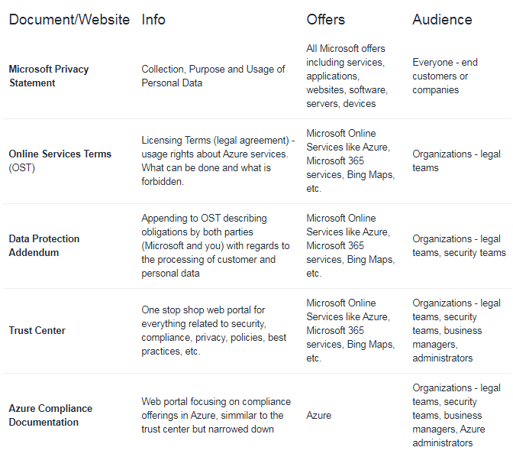

Slide 73
Azure Sovereign Regions
Azure Sovereign Regions provide Azure services in markets with very strict regulatory requirements
Azure Government designed for the US government
Separate instance of Azure (lifecycle, services, portal, etc.)
Physically isolated from other Azure regions
Only autorized scanned personel can get access
Azure China designed for the Chinese market
Separate instance of Azure (lifecycle, services, portal, etc.)
Physically isolated from other Azure regions
Operated by a Chinese telecom company called 21Vianet

Slide 74
Cost Affecting Factors
Base Cost
Resource Types – All Azure services (resources) have resource-specific pricing models. Typically consisting of one or more metrics.
Services – Azure specific offers (Enterprise, Web Direct, CSP, etc.) have different cost and billing components like prepaids, billing cycles, - discounts, etc.
Location – running Azure services vary between Azure regions
Bandwidth – network traffic when uploading (inbound/ingress) data to Azure or downloading (outbound/egress) from Azure
Savings
Reserved Instances
Hybrid Benefits

Slide 75
Azure Reservations
Purchase Azure services for 1 or 3 years in advance with a significant discounts
Reserved instances – Azure Virtual Machines
Reserved capacity – Azure Storage, SQL Database vCores, Databricks DBUs, Cosmos DB RUs
Software plans – Red Hat, Red Hat OpenShift, SUSE Linux, etc.
Reservations are made for 1 or 3 years
Azure Spot VMs
Purchase unused Virtual Machine capacity for significant discount
How it works
Significant dicount for Azure VMs
Capacity can be taken away at any time
Customer can set maximum price after discount to keep or evict the machine
Best for interruptable workloads (batch processing, dev/test environments, large compute workloads, non-critical tasks, etc.)

Slide 76
Hybrid use Benefit
Use existing licenses in the cloud
Use existing licenses in the Azure
Windows Server
Azure VM
RedHat
Azure VM
SUSE Linux
Azure VM
SQL Server
Azure SQL Database
Azure SQL Managed Instance
Azure SQL Server on VM
Azure Data Factory SQL Server Integration Services
Tools
Pricing calculator – estimate the cost of Azure services
Select service
Adjust parameters (usage)
View the price
Total Cost of Ownership (TCO) calculator – estimate and compare the cost of running workloads in datacenter versus Azure
Define your workloads
Adjust assumptions
View the report

Slide 77
Azure Cost Management
A centralized service for reporting usage and billing of Azure environment
Self-service cost exploration capabilities
Budgets & alerts
Cost recommendations
Automated exports
Minimizing Costs in Azure
Azure Pricing Calculator to choose the low-cost region
Good latency
All required services are available
Data sovereignty/compliance requirements
Hybrid use benefit and Azure Reservations
Azure Cost Management monitoring, budgets, alerts and recommendations
Understand service lifecycle and automate environments
Use autoscaling features to your advantage
Azure Monitor to find and scale down underutilized resources
Use tags & policies for effective governance

Slide 78
Labs
https://github.com/MicrosoftLearning/AZ-900T0x-MicrosoftAzureFundamentals/tree/master/Instructions/Walkthroughs

Slide 79
Thank you !

